Slide 1
There are a number of different types of computer.
1) Write down the type of computer that best fits the following descriptions.
(a) A computer that is difficult to move and has a separate monitor and keyboard.
PC/desktop
(b) A portable computer that includes a physical keyboard.
Laptop
(c) A thin portable computer that has a touch screen and a battery in a single unit, not normally used to make phone calls.
Tablet
(d) A mobile phone that can be used as a computer.
Smartphone

Slide 2
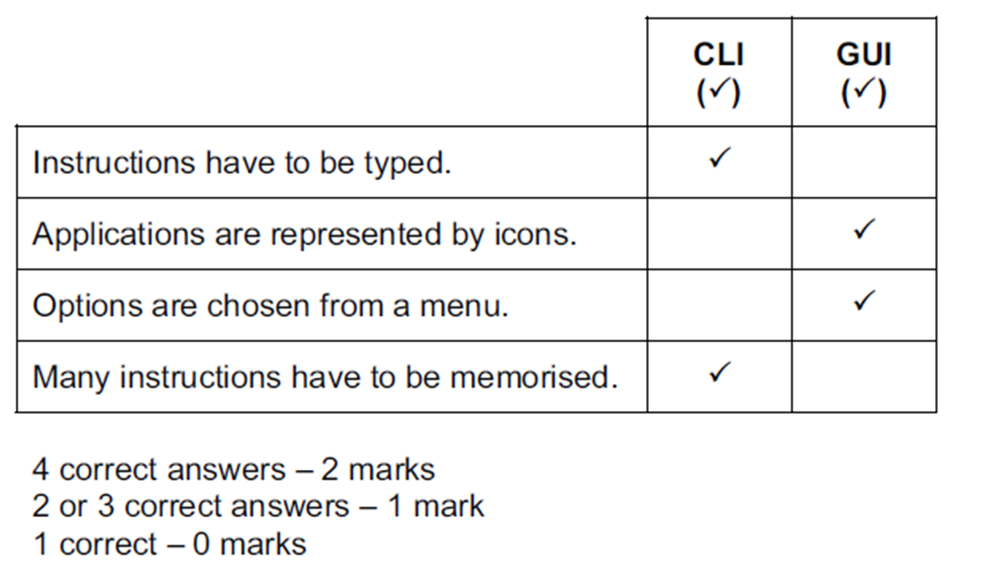
Tick whether the following are features of operating systems containing a command line interface (CLI) or a graphical user interface (GUI).

Slide 3
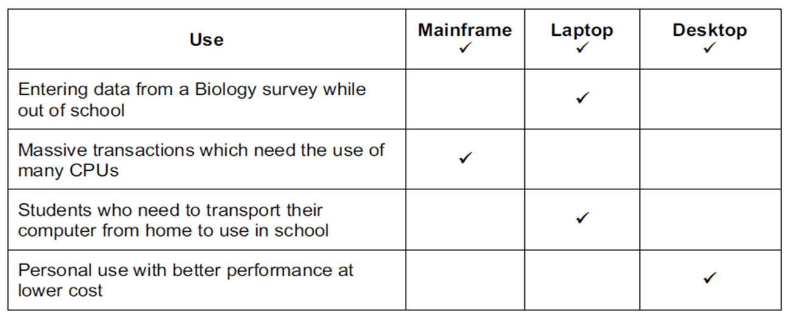
Tick the type of computer which would be most appropriate for each use of ICT.

Slide 4
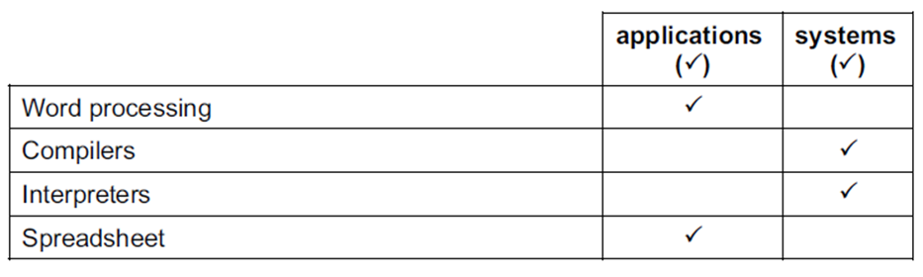
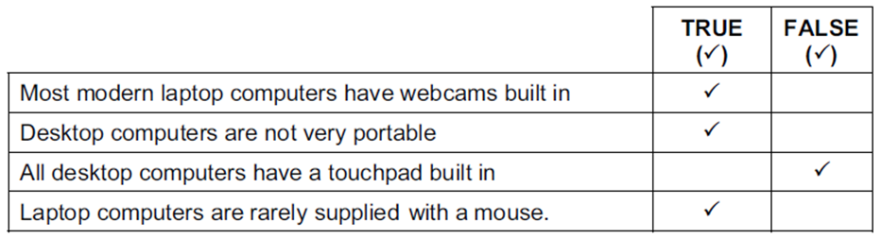
Tick whether the following are examples of applications software or systems software.
Tick whether the following statements about desktop and laptop computers are true or false.

Slide 5
Smart phones are used to send and receive emails with and without attachments.
Describe four other ways in which emails can be managed on a smart phone.
Place/organise in folders
Sort the emails
Flag for importance
Delete from phone
Delete from server
Search/filter emails
Archive emails

Slide 6
Discuss the advantages and disadvantages to a teacher of using a tablet computer instead of another type of computer.
Advantages
More portable than PC/laptop
Can access internet in most places if they are part of a phone plan unlike PC/laptop
Larger screen area than smartphones
Carry resources round with them
Disadvantages
Smaller screen area than laptop/PC
Touch screen so keyboard can be more difficult to use compared to laptop/PC
Not as portable as smartphone
Cannot access internet in as many places if they are not part of a phone plan
More difficult to produce complex worksheets than PC/laptop

Slide 7
Fill in the missing words:
(a) The input device used in flight simulation is a joystick
(b) The type of memory used to store the work that the user is currently working on is RAM
(c) A medium used to backup data is magnetic tape
ROM, Bar Code Reader, RAM, Magnetic Tape, Joystick, OCR, Chip Reader & MICR

Slide 8
Discuss why different user interfaces require the use of different types of input devices.
With a GUI you just click on an icon
With a GUI icons represent applications
Separate windows are used for different pieces of work/software
With a GUI menus are offered to help choose an action
Moving a mouse enables users to manoeuvre a pointer around a screen
A mouse can be used to drag windows/icons around a screen
People with physical disabilities can use a trackerball to manoeuvre the pointer around a screen
Pointing devices are easier to control a pointer/menu selection/icon clicking
Joysticks can be used to mimic the behaviour of a mouse
Buttons on the mouse enable users to select icons
Buttons on a mouse enable users to see menus on a screen
Touchscreen can be used to directly select options from a screen

